Slide 1
Inner Queries
Presented by
M. Sharanya

Slide 2
Inner queries
In SQL (Structured Query Language), an inner query, also known as a subquery or nested query.
It is a query that is embedded within another query to manipulate and retrieve data from a database.
Inner queries are enclosed in parentheses and are used to filter, aggregate, or manipulate the results of an outer query.

Slide 3
Benefits of Using Inner Queries:
Code readability
Data filtering
Aggregation
Dynamic values

Slide 4
Types of Inner Queries:
Single row subquery
Multi-row Subquery
Single column subquery
Multi-column subquery

Slide 5
Single row subquery
It is also known as Scalar subquery
A single row subquery is an inner query that returns a single value. This value can then be used in the outer query for comparison or calculation.
The inner query value is evaluated with outer query using =, !=, <, >, <=, >=

Slide 6
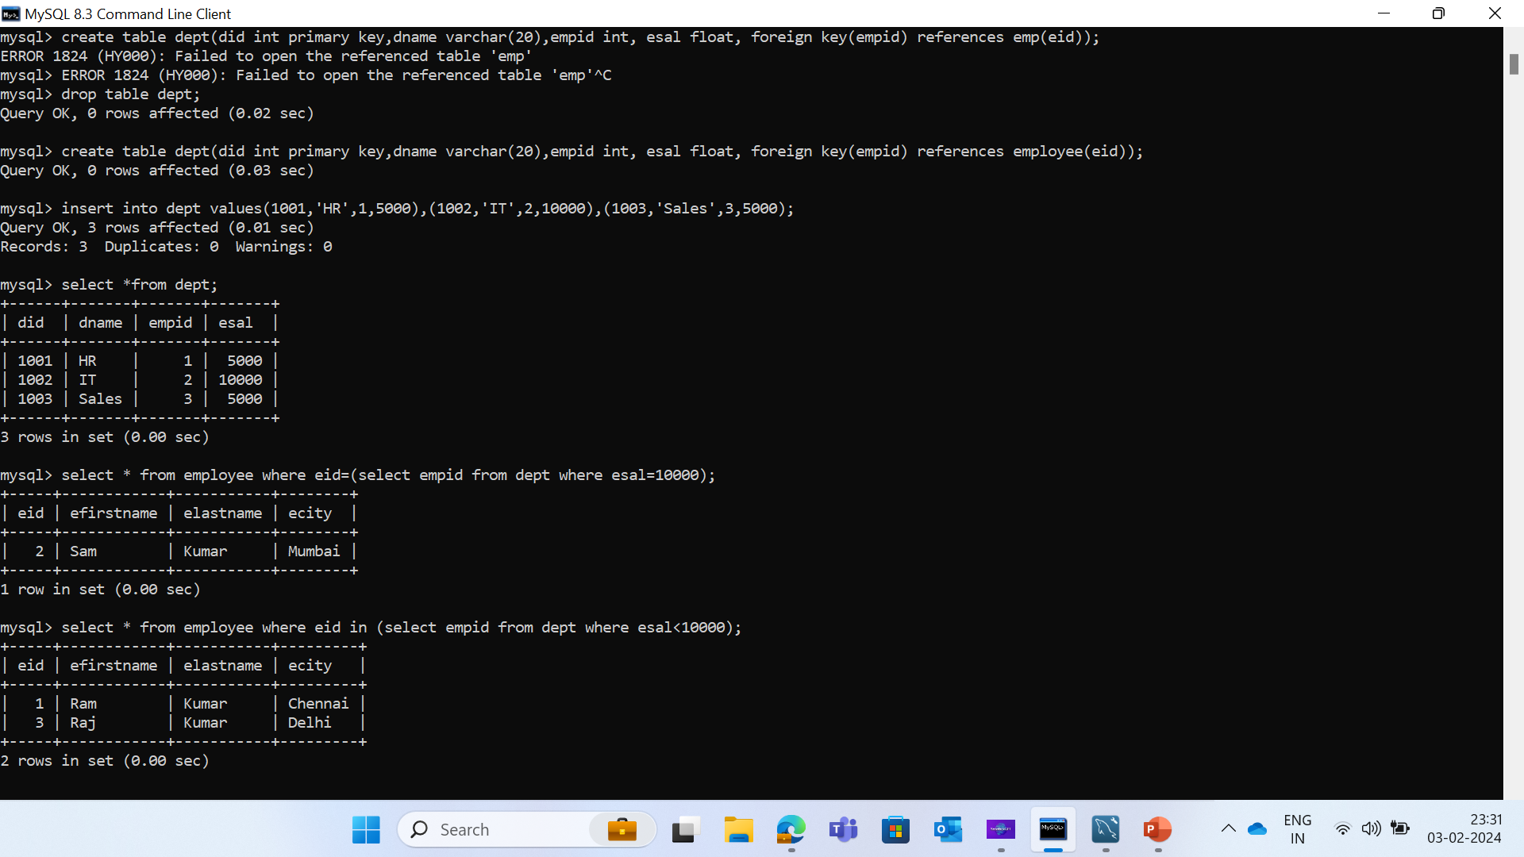
Syntax
select * from employee where eid=(select empid from dept where esal=10000);

Slide 7
Multi-row Subquery
A multi-row subquery returns multiple rows of data, which can be used to filter the results of the outer query based on a specific condition.
The inner query values are evaluated with outer query using any, all, in, not in, exists and not exists.

Slide 8
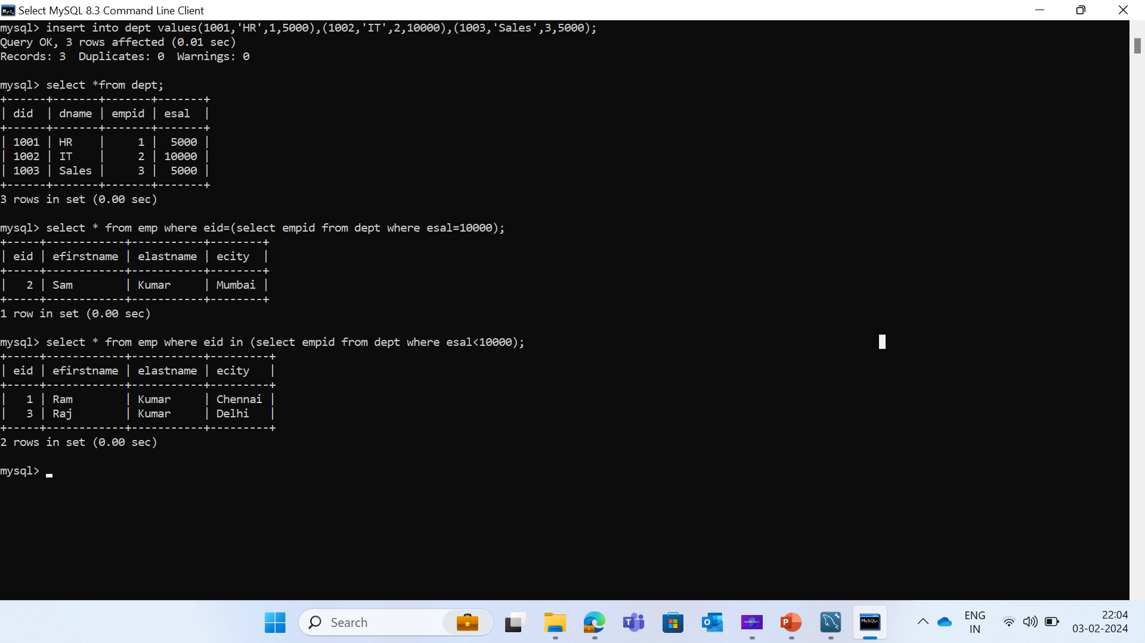
Syntax
select * from employee where eid in (select empid from dept where esal<10000);

Slide 9
Single Column subquery
A single-column subquery returns only one column.
It is typically used with operators expecting a single value.

Slide 10

Syntax
select dname from dept where esal > (select avg(esal) from dept);

Slide 11
Multiple Column subquery
A multiple-column subquery returns more than one column.
It can be used in situations where multiple values need to be compared.

Slide 12
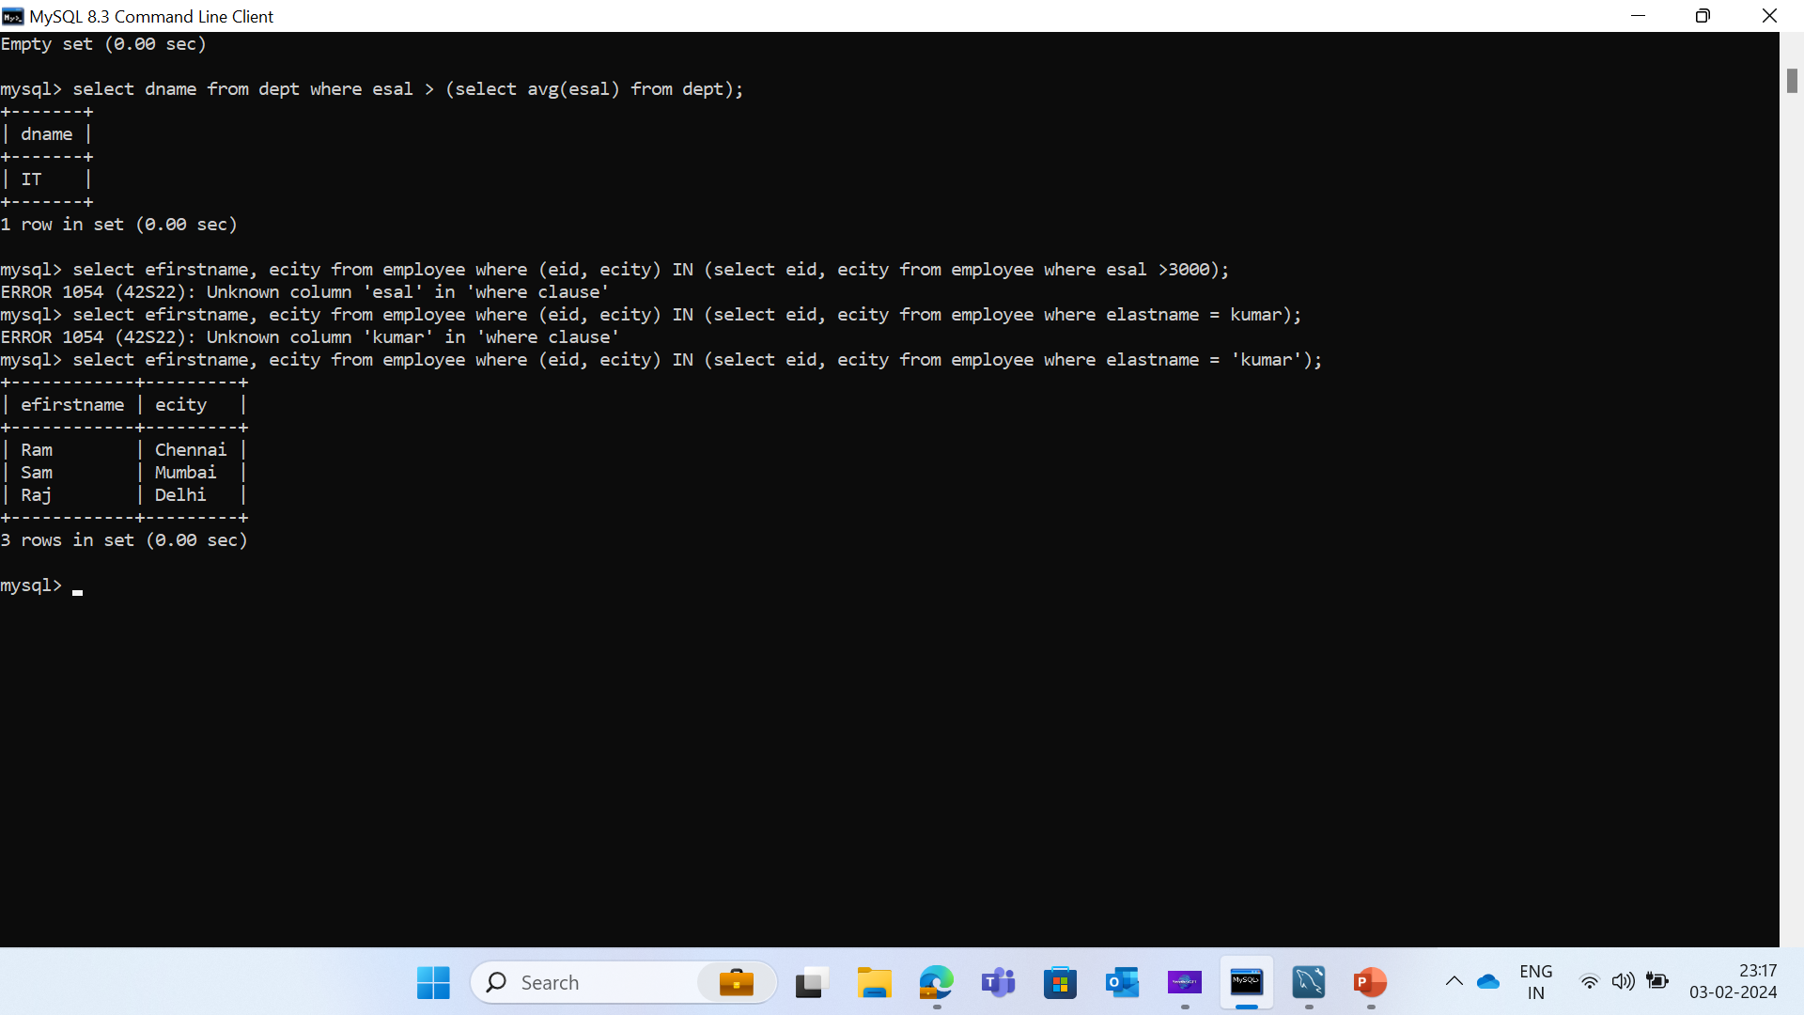
Syntax
select efirstname, ecity from employee where (eid, ecity) IN (select eid, ecity from employee where elastname = 'kumar’);

Slide 13
Conclusion
In conclusion, inner queries in SQL provide a powerful and flexible way to access and manipulate data from multiple tables in a single SQL statement. By using different types of inner queries, you can achieve complex data filtering, aggregation, and dynamic value manipulation to meet your data retrieval needs.

Slide 14
Thank you

